Slide 1
Eniac Discount Pricing Strategy
Presented by:
Satyendra KUMAR Hassan MERAI Nabil ZRIGUI

Slide 2
Outline
Most sold brands
Most revenue generation
Relationship between discount and product sale
Conclusion and recommendations

Slide 3
Is Product Discount a Smart Choice?
Marketing Team
Beneficial in the long run
Improves customer satisfaction
Increases the bottomline
Investors
Impact of aggressive discount
Stick to quality segments

Slide 4
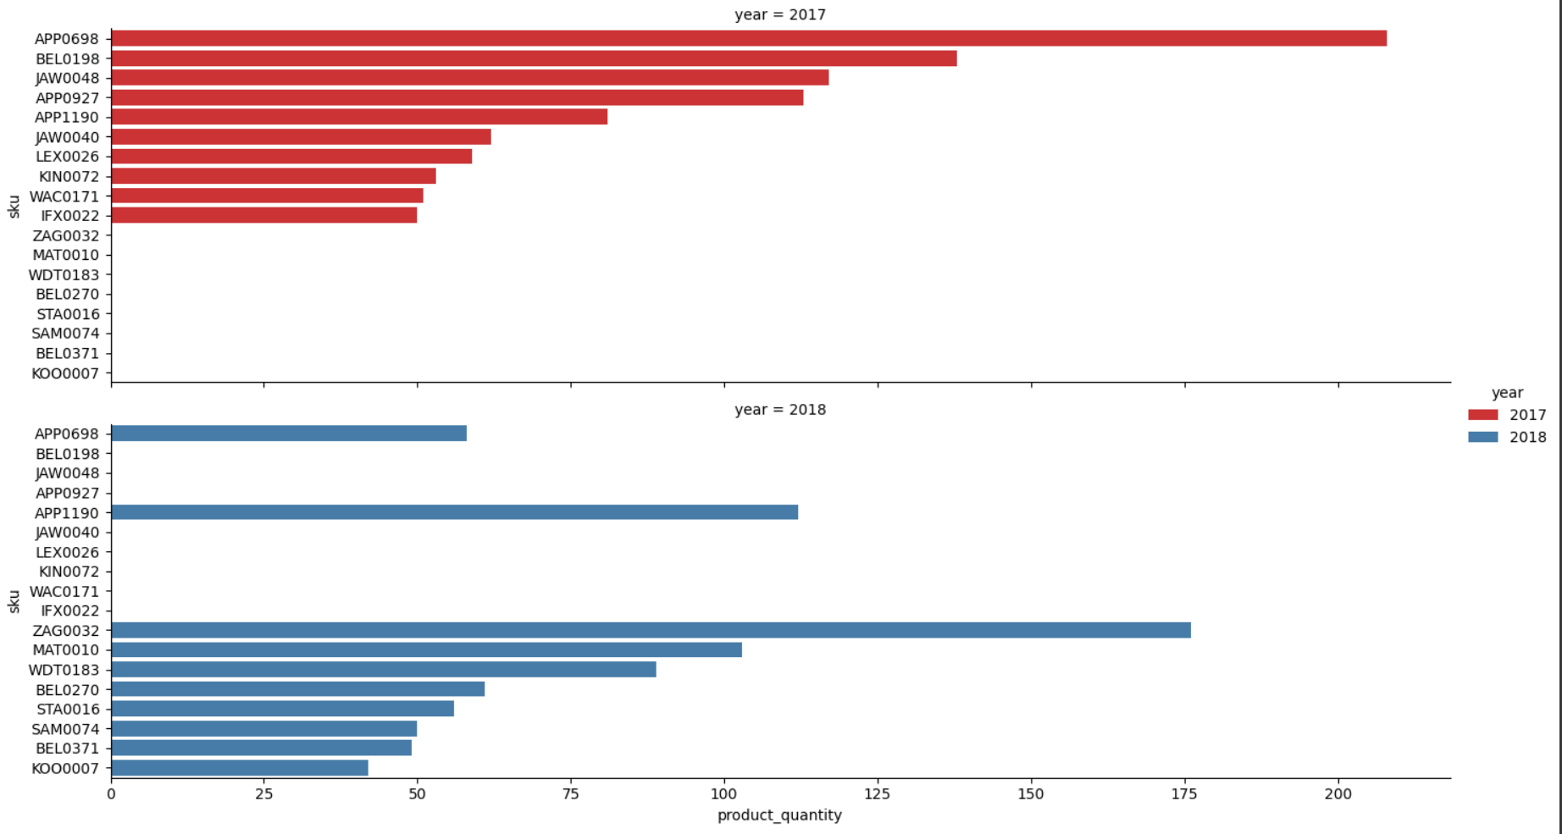
How Selling Behavior changes from 2017 to 2018

Slide 5
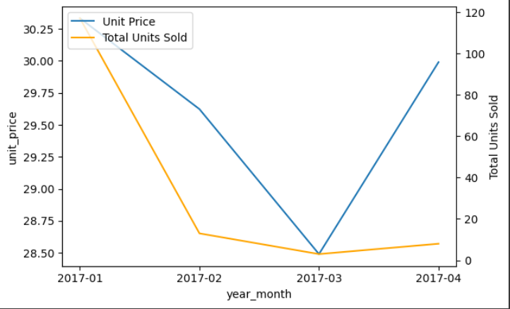
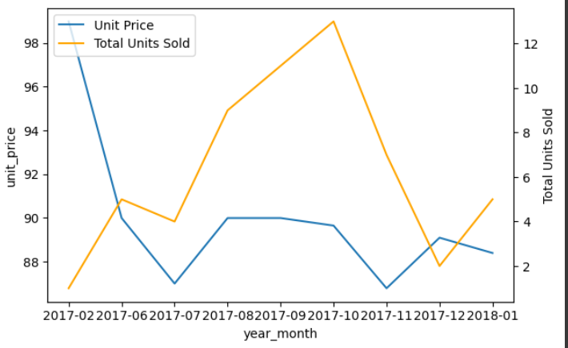
Two Examples from The Best Sold two items in The Time Range
Top: Activity Monitor Band Bottom: DLink Baby Monitor

Slide 6
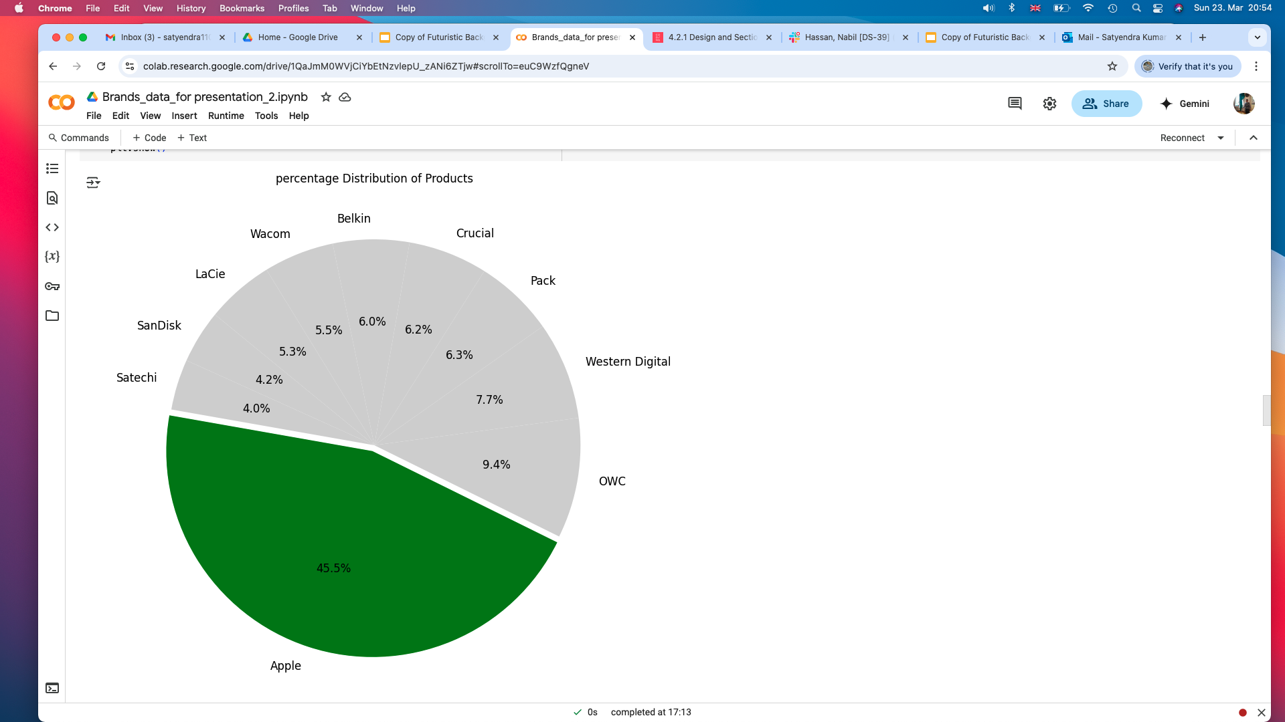
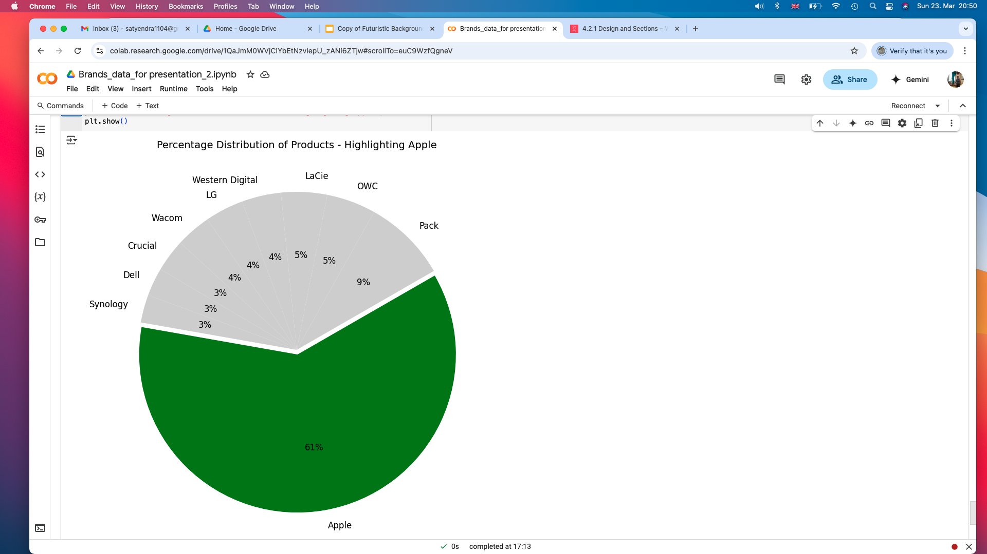
Percentage Product Distribution
Percentage Revenue
by Brands

Slide 7
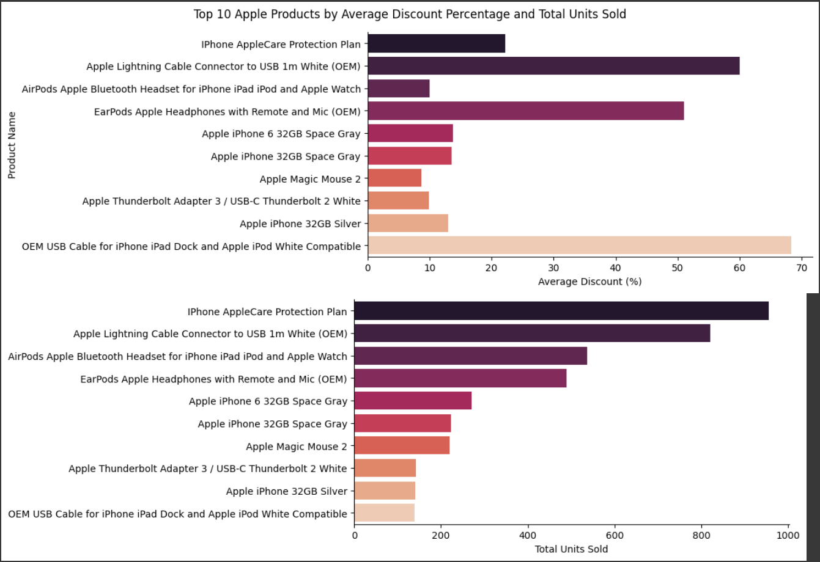
Average Discount and Total Units sold of The Top 10 Apple Product

Slide 8
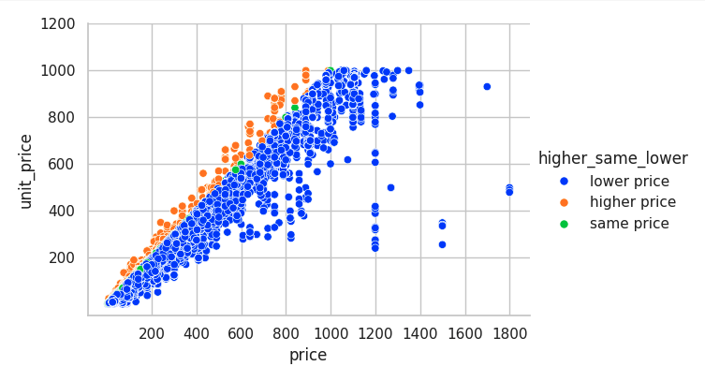
The Relationship Between The actual Price and The Selling Price
Anomalies

Slide 9
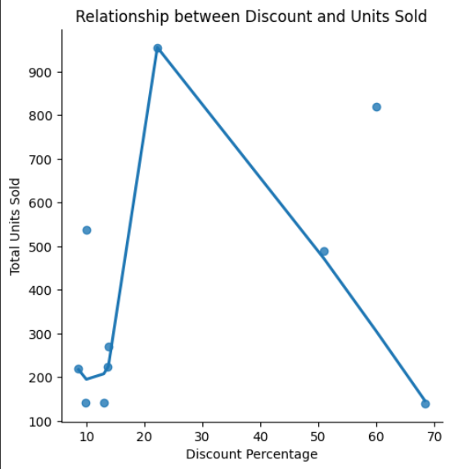
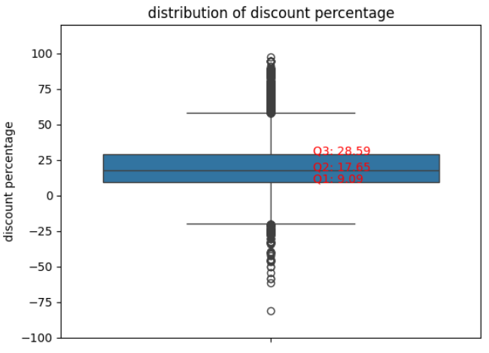
The Three Quartiles and Outliers of The Discount Percentage
The Best Discount Rang is between 20% and 35% , with that we can say safely the outliers start from 35%
Discount percentage
Q1 9.09
Q2 17.65
Q3 28.59
IQR = Q3 - Q1 = 19.5
Q3 + 1.5 * IQR = 57.84 %

Slide 10
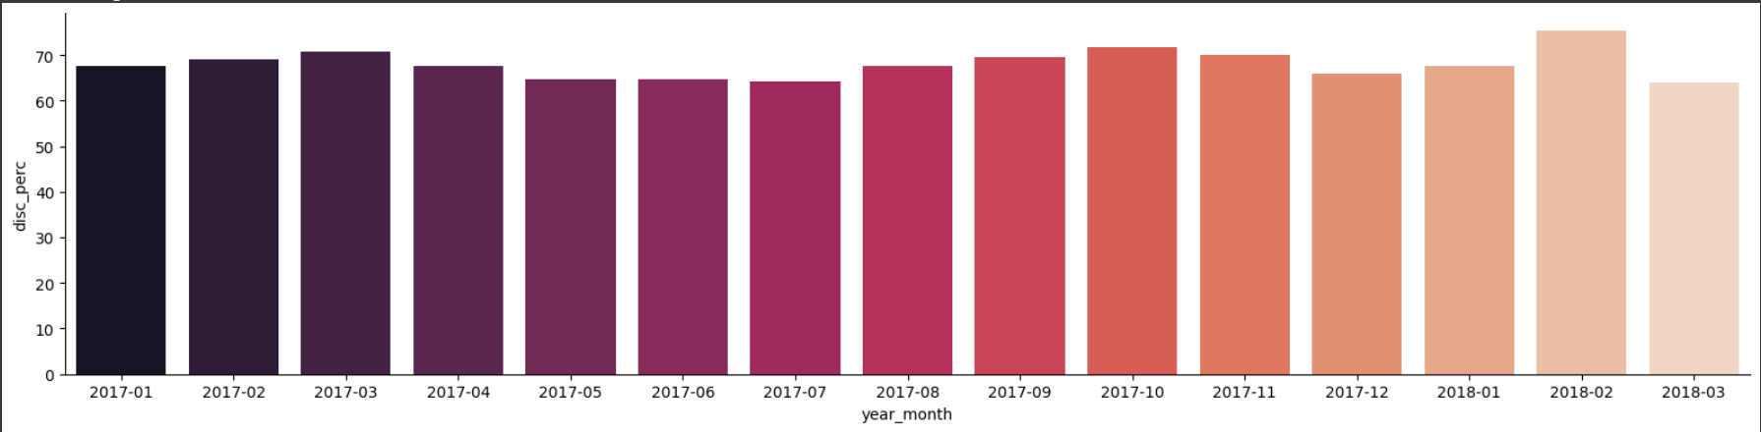
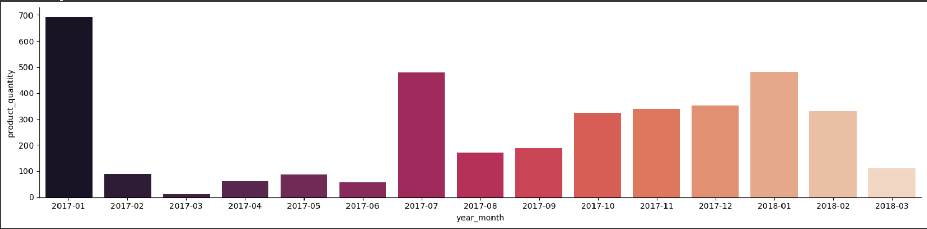
Percentage and The Amount being Sold of Product With Aggressive Discount

Slide 11
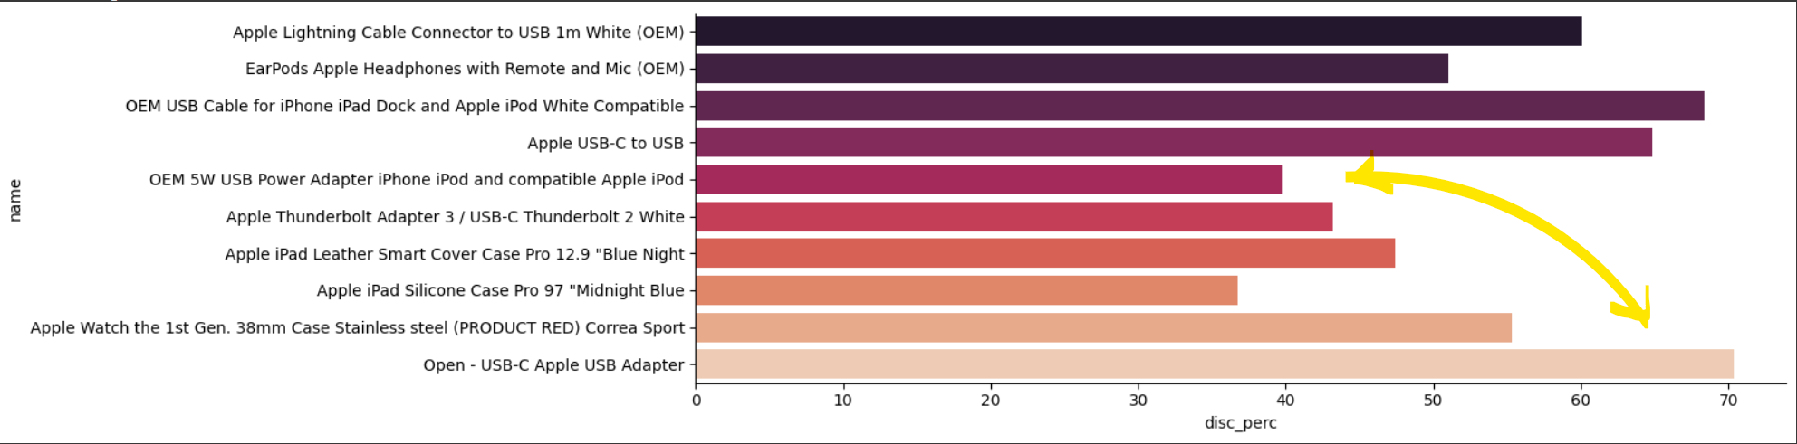
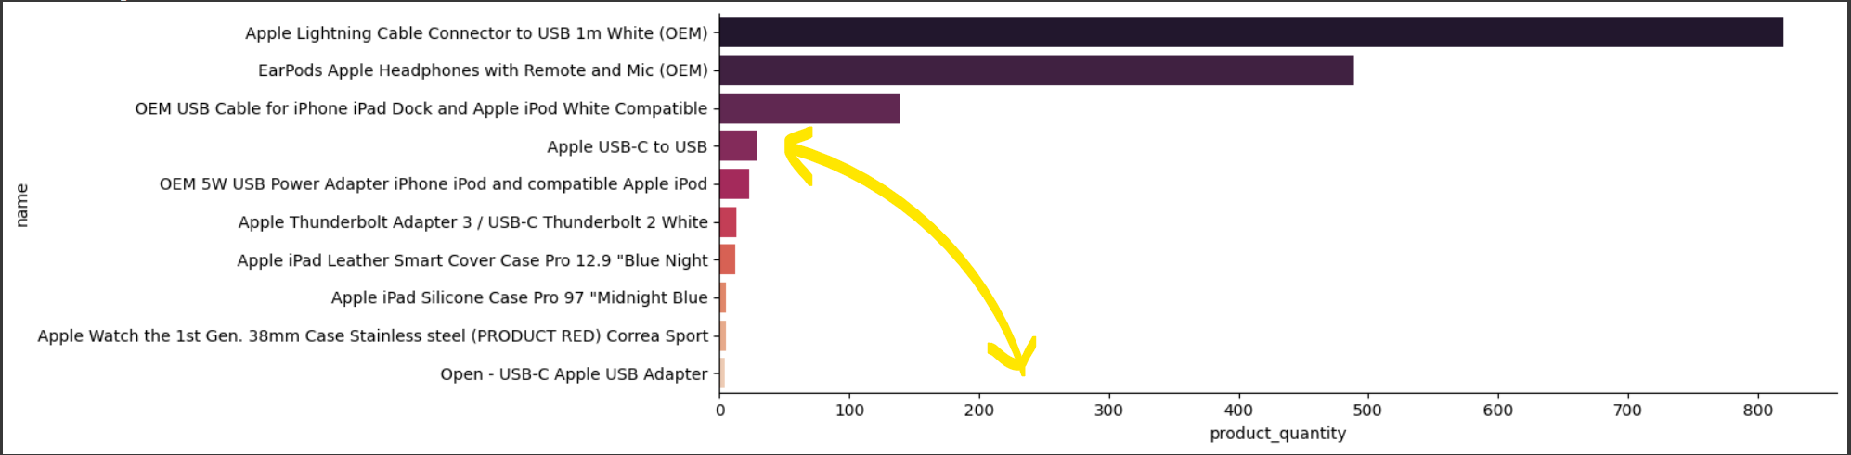
Top 10 Apple best sold Products with Aggressive Discounts

Slide 12
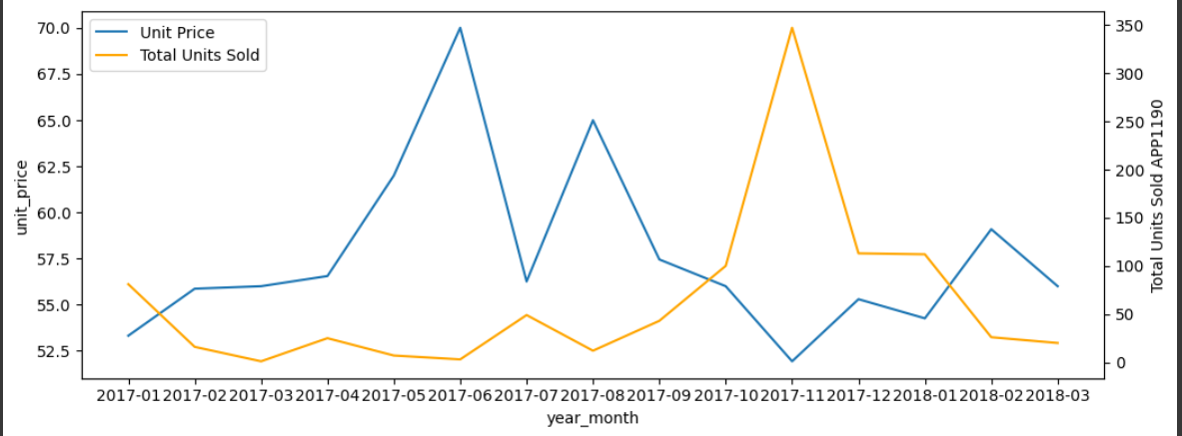
Best sold Apple Product(priced more than 50€)
The relationship between the number of sold items and the unit price over time

Slide 13
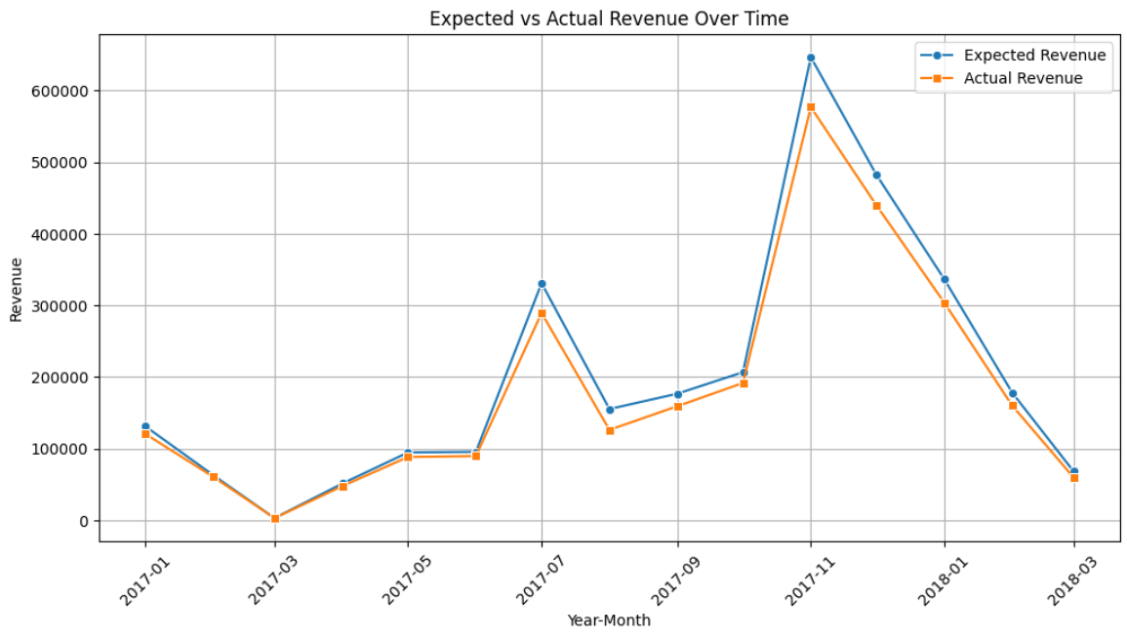
Expected Vs. Actual Revenue of The Apple Products over Time

Slide 14
1. The discounts should not exceed 35% or 40% at most.
2. They should apply to selected products rather than all items, especially those nearing out date and expiration.
3. Promotions and discounts should be limited to specific seasons rather than spread throughout the year.
It would be advisable for the marketing department to review our report to determine the best timing for these offers.
Furthermore, we were unable to determine net profit and the impact of the discounts on it, as the data does not contain relevant information. Instead, we analyzed overall revenue as an indicator of net profit. Also there is a shortage in customers satisfaction as well.
Conclusions and Recommendation

Slide 15

Thank You For Your Attention

